Slide 1
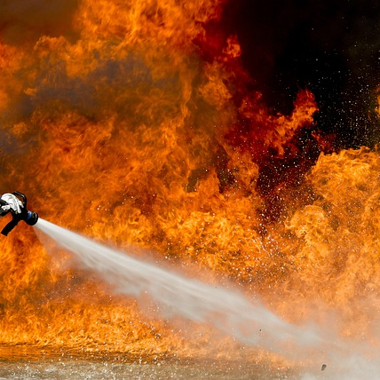
AEGIS FLARE
iot ENABLED ROBOTIC FIREFIGHTER

Slide 2
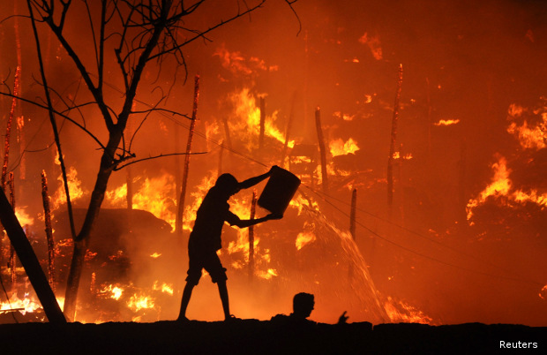
Table of content
INTRODUCTION
EXISTING TECHNOLOGIES
SYSTEM OVERVIEW
HARDWARES & SOFTWARES
KEY FEATURES
FLOW CHART
PERFORMANCE MATRIX
PROTOTYPE
CONCLUSION

Slide 3
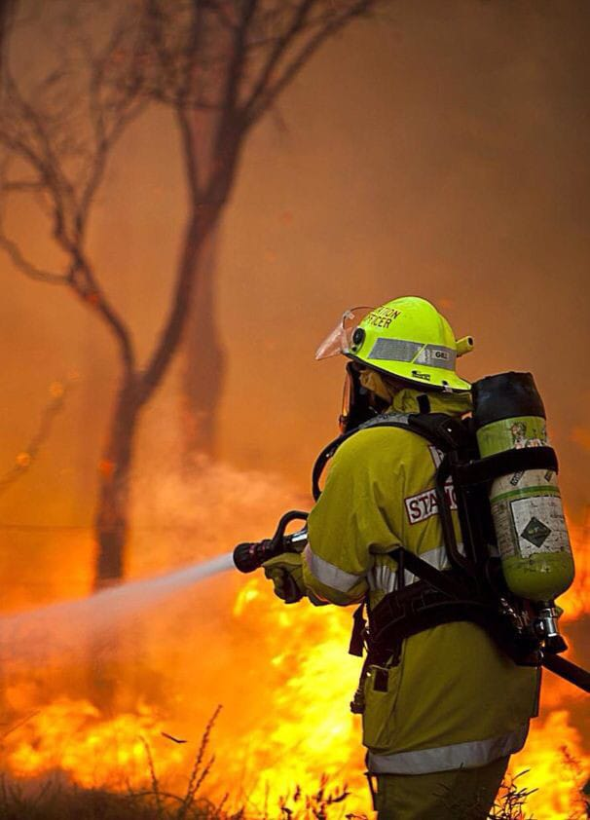
INTRODUCTION
Fire safety remains a critical concern in residential, commercial, and industrial settings. Traditional fire detection and suppression systems often rely on manual interventions and can be prone to delays, leading to significant property damage and loss of life.
The introduction of IoT and robotics offers new possibilities for improving fire safety through automation and enhanced monitoring.
By combining IoT-enabled sensors, advanced image processing, and autonomous robotic mechanisms, Aegis Flare promises a more efficient and reliable fire detection and suppression solution.
This presentation provides an in-depth look at the development and capabilities of this innovative system.

Slide 4
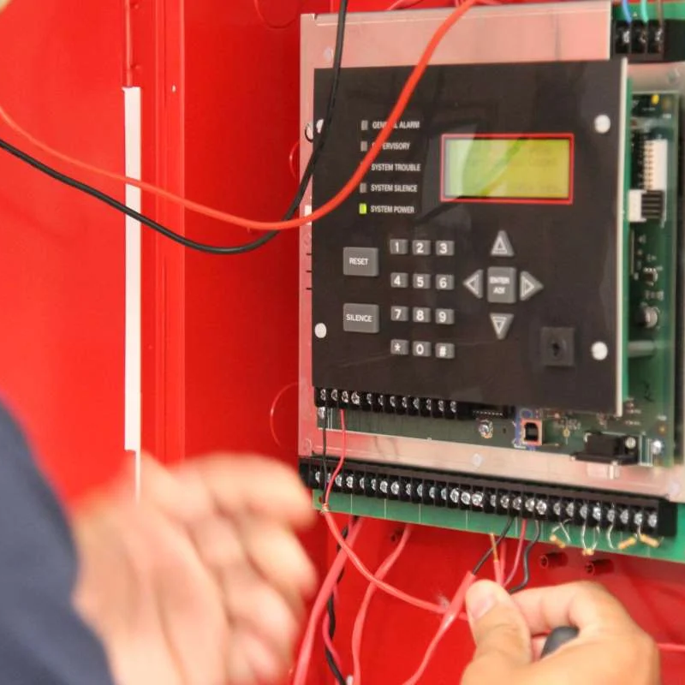
EXISTING TECHNOLOGIES
Traditional fire detection systems, such as smoke detectors and heat sensors, are vital in alerting occupants to potential fire hazards.
Manual alarms and sprinkler systems are also common, providing an initial line of defense against fires.
However, these systems have significant limitations. Smoke detectors can be prone to false alarms and may not provide sufficient warning time. Heat detectors, while useful, often react too slowly to prevent significant damage.
Manual alarms depend on human intervention, which can be delayed or unreliable in critical situations. Sprinkler systems, although effective, can cause extensive water damage and are not always suitable for all types of fires.

Slide 5
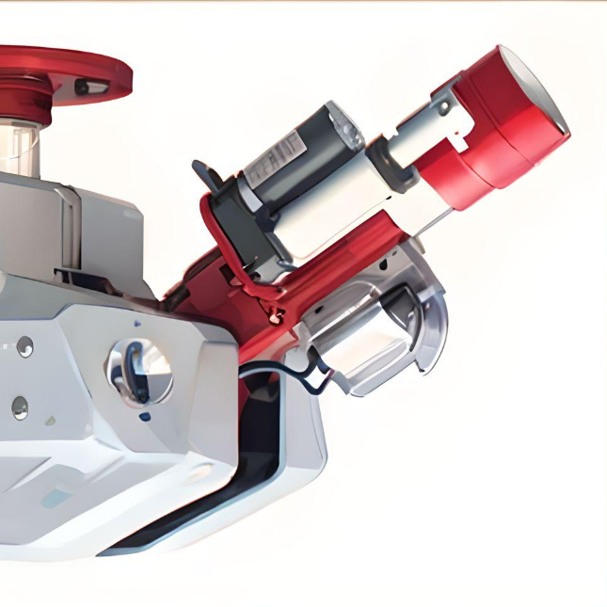
PROPOSED SYSTEM-OVERVIEW
Our system integrates IoT and robotic technologies to enhance fire detection and suppression. It uses IoT-enabled sensors and advanced image processing algorithms to accurately detect fire and smoke patterns.
The system operates autonomously, identifying and locating fires in real-time without human intervention, significantly enhancing fire safety.
This rapid detection and response capability significantly enhances fire safety, reducing the potential for property damage and loss of life.
Additionally, its enhanced monitoring and communication features ensure prompt alerting of emergency services, improving overall fire management.

Slide 6


Feature Ideation:Software: Software features pertain to the programming and algorithms that drive functions like fire detection, image processing, and communication.
User-Centric Design:Software: Software design concerns the user experience through interfaces and control systems, ensuring ease of use and clarity in alerts and notifications.
Technology Integration: programming and algorithm development for AI, image processing, and communication protocols.
Ageis flare – hardware requirements
Feature Ideation: Hardware: Hardware features involve the physical components of Aegis Flare, such as the robotic arm, cameras, and sensors.
User-Centric Design: Hardware: Hardware design focuses on the physical appearance and usability of Aegis Flare, including the design of the robotic arm and user interfaces.
Technology Integration: Hardware: Hardware integration entails selecting and integrating physical components like motors, cameras, and sensors.
Software requirements

Slide 7
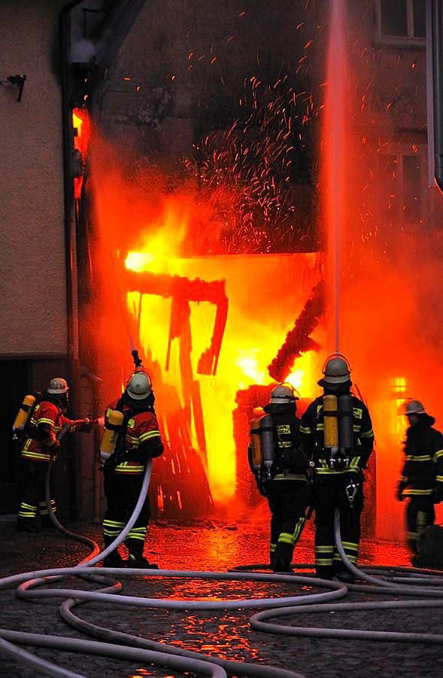
KEY FEATURES
Aegis Flare boasts several key features that set it apart from traditional fire detection and suppression systems. Firstly, its autonomous operation allows for continuous monitoring and immediate response to fire incidents.
Secondly, the integration of advanced image processing enables the system to accurately detect fire and smoke, reducing the likelihood of false alarms.
Aegis Flare's advanced features ensure swift notification of authorities and emergency services in case of a fire. Its IoT connectivity allows real-time data exchange and remote monitoring, making it an effective and reliable solution for modern fire safety needs.

Slide 8
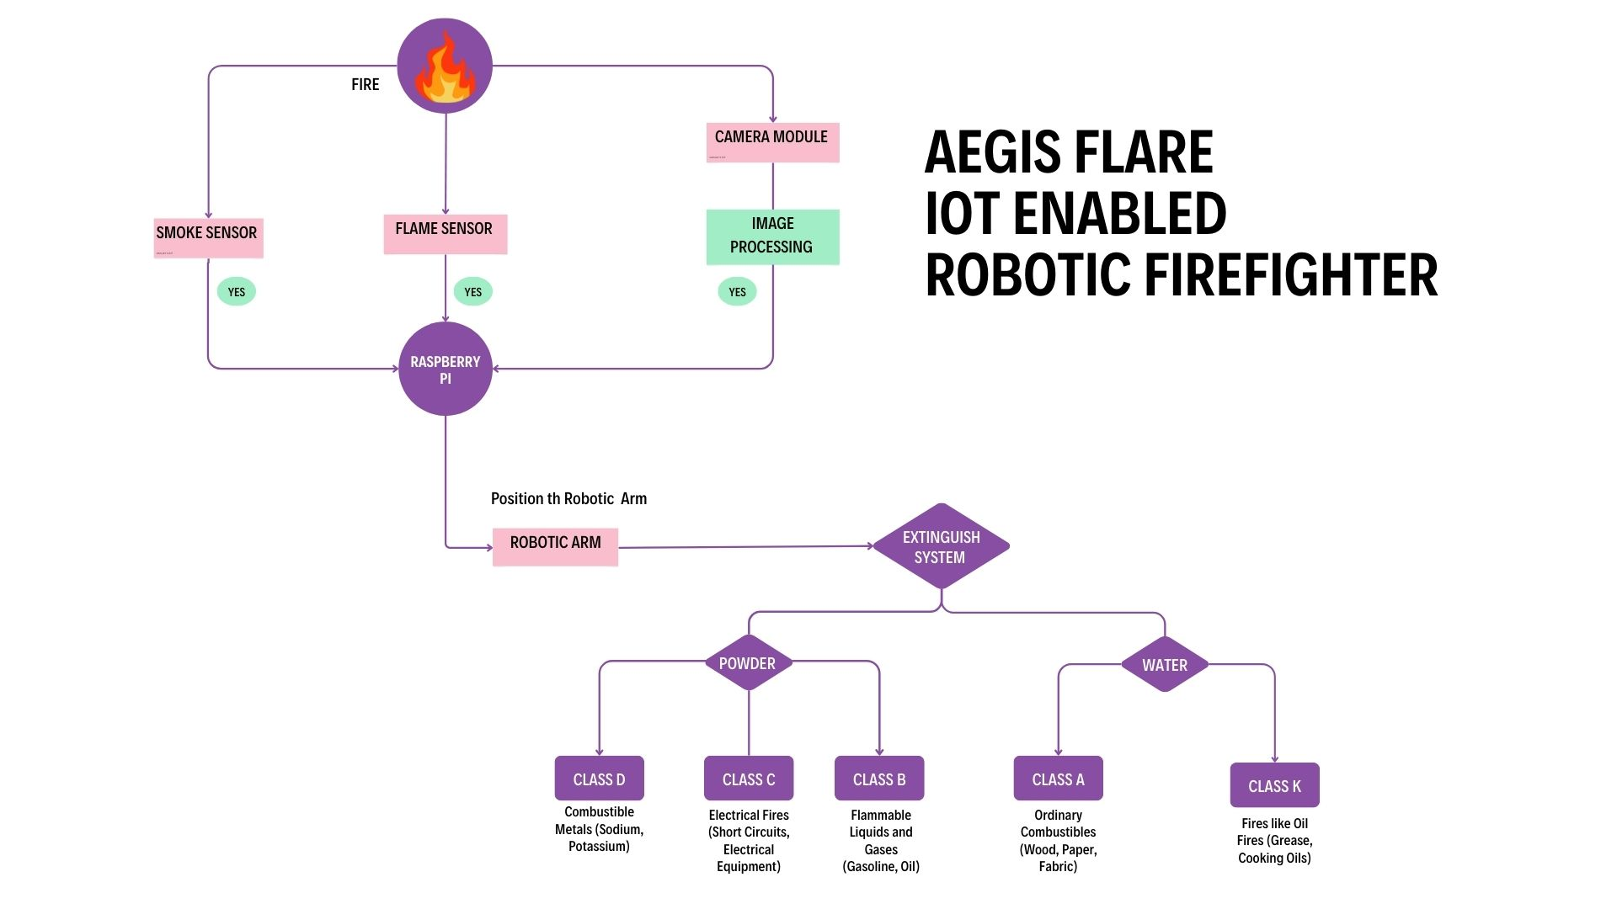
FLOW CHART
TOPIC 01 | TOPIC 02 | TOPIC 03 | TOPIC 04 | TOPIC 05
Item 01 | Text | Text | Text | Text
Item 02 | Text | Text | Text | Text
Item 03 | Text | Text | Text | Text
Item 04 | Text | Text | Text | Text
Item 05 | Text | Text | Text | Text
Item 06 | Text | Text | Text | Text
Item 07 | Text | Text | Text | Text
Item 08 | Text | Text | Text | Text
TOTAL | Text | Text | Text | Text

Slide 9

PERFORMANCE METRICS
The performance metrics for the Aegis Flare system include detection accuracy and response time.
Detection accuracy measures the system's ability to correctly identify fire incidents and minimize false alarms.
Response time evaluates how quickly the system can detect a fire and initiate the appropriate response.
The results indicate that Aegis Flare achieves high detection accuracy and rapid response times, outperforming traditional fire detection and suppression methods.
These metrics demonstrate the system's effectiveness in providing early fire detection and swift response, reducing the potential for property damage and loss of life.

Slide 10
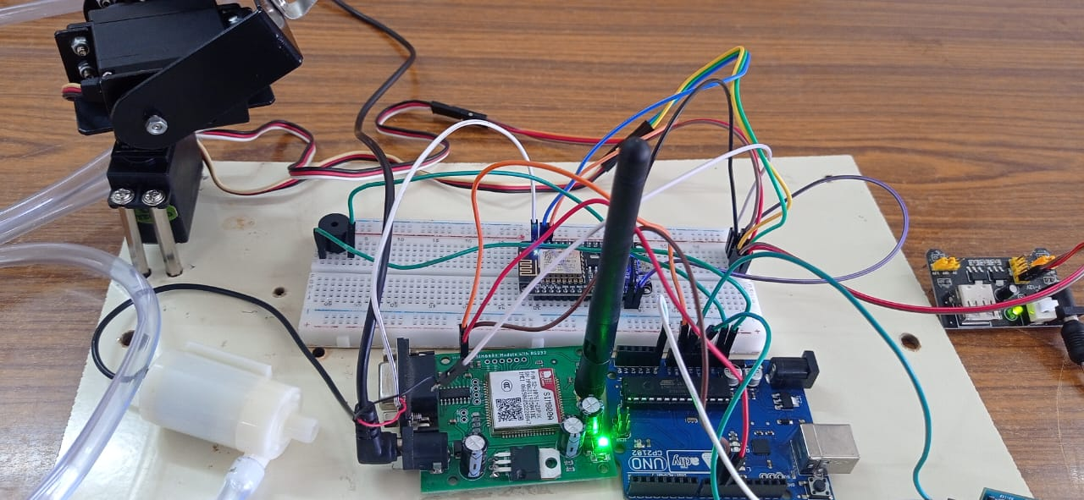
PROTOTYPE

Slide 11
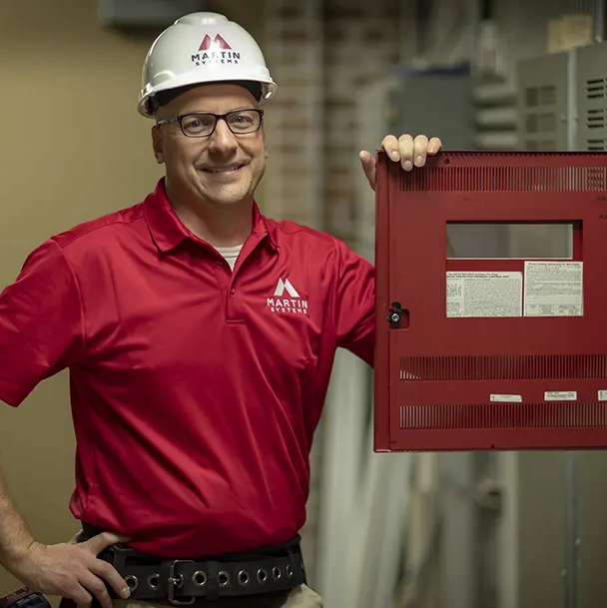
CONCLUSION
The Aegis Flare system represents a groundbreaking approach to fire detection and suppression, integrating advancements in IoT, robotics, and image processing technologies.
Its ability to detect fires early and respond promptly reduces potential damage and loss of life, while IoT integration ensures continuous monitoring and remote accessibility.
Future work will refine capabilities and expand applications, keeping Aegis Flare at the forefront of fire safety innovation.
Thank you for your interest, and we look forward to addressing any questions

Slide 12
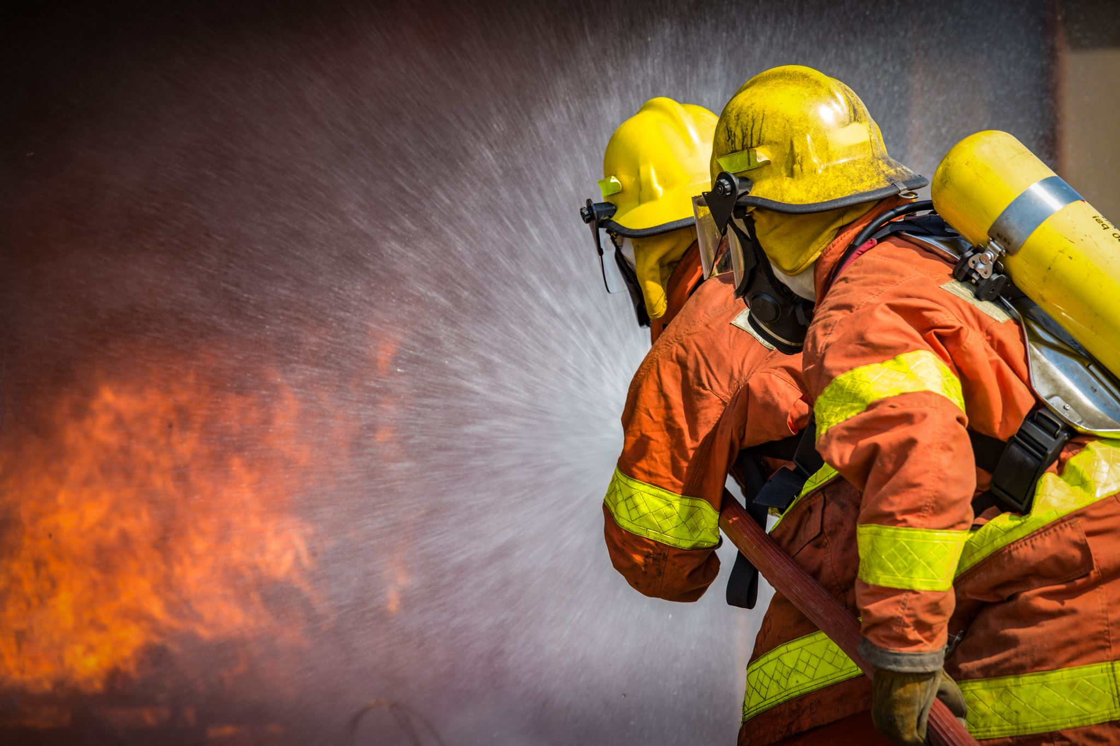
Thank you

